Slide 1


FIERCE CONVERSATIONS
Notes:
Welcome, and thank you for joining today’s introduction to the Fierce Conversations program for leadership.
We’ll start with a short introduction of our team and why we’re bringing Fierce to our leadership team first. Then we will spend the remainder of our time on what is Fierce Conversations and we’ll end with a Q and A

Slide 2
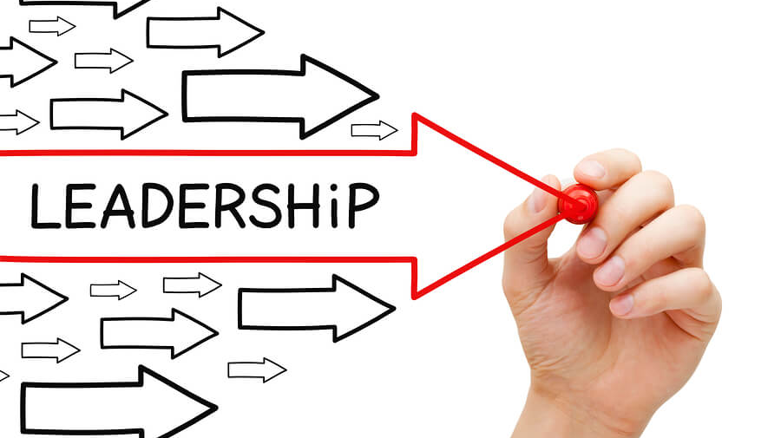
Notes:
Now let’s talk about why we’ve invited you, as the leadership of this organization, to experience the Fierce Conversations Training Workshops.
When our team puts together training programs and evaluate success, we don’t just look at the number of participants or the quality of the delivery of training in our evaluations, but also we ask questions about the likelihood of someone using the new skills, the culture surrounding bringing new ideas to work, and the support individuals receive when trying new skills. In other words, we are very interested in the transfer of learning that occurs after the workshop.
And that’s where leaders come into the picture. Most supervisory support for professional growth looks like approval to attend a workshop or conference. But support is not just approval. It’s creating the bridge between what is learned and daily use. Why is this important? Because training, when done right, is what enables employees to accelerate the ability to accomplish strategic initiatives, goals, and daily work tasks.
There’s an expert on learning evaluation named Robert Brinkerhoff and much of his work centers around how we apply the training, not how well the training is done. A critical factor that is significantly linked to learning transfer, is the involvement of leaders before, during, and after the training. There is a 65% increase in retention and application. This is where you, as extended leadership have the potential to make a huge difference.
By learning what your employees are learning, you’ll be able to ask questions and support the transfer of learning, which ultimately is what helps accelerate achievement of strategic goals within each of your departments.
If we as an organization are truly interested in the development of our employees, we need to elevate our support of employees in applying new skills into their work. In order to be successful in bringing a culture of candid productive dialogue between individuals, teams, and departments at our company, we need to get the leaders involved.

Slide 3
FIERCE CONVERSATIONS
Notes:
So now you know the Why we are bringing this to you, as the leadership of our organization. Let’s dive into what is Fierce Conversations.

Slide 4
Reflect
Can you remember a time you or someone on your team sent a perfectly innocent email only to discover it was taken totally out of context?
How many meetings have I sat in where I knew the real issues were not being discussed?
How often do I find myself – just to be polite – saying things I don’t mean?
What is the conversation I've been unable to have with colleagues that if I were able to have might make the difference?
Notes:
To set the stage, I’m going to ask you a series of questions to reflect on. These are just for you to think about, you will not have to answer them in our group today.
Ask questions on slide
Fierce Conversations will address all these issues. Fierce is a leadership development program with over 20 years of research and refinement. It’s built on a single premise: what gets talked about, how it gets talked about, and who is invited to that conversation will determine what will and won’t happen.
​
The first couple slides come from the Foundations workshop which sets the stage by defining what is a Fierce conversation and what it is not, and then sharing some transformational ideas.
Before we dive into the overview, lets define the word Fierce: what do you think of when you hear this word?​
It’s not brutal, but powerful. It’s not mean, but meaningful. It’s not aggressive but enriching, bold, and authentic.

Slide 5
A Fierce Conversation is one in which we come out from behind ourselves into the conversation, and make it real.
Notes:
Here’s how we define a Fierce Conversation:
What does it mean to “make it real?”
Yes, and while some people are afraid of the real, (uncomfortable, risky) it is the unreal conversations that ought to concern us. They are incredibly expensive for an organization and for the individual.

Slide 6

Fierce training programs
CUSTOMIZABLE
SUSTAINABLE
STRATEGIC
Each one of our training solutions can be customized to best serve your business needs.
FIERCE FOUNDATIONS®
A revolutionary approach to conversations that matter.
FIERCE TEAM®
Make better and more inclusive decisions. Hear from every voice in the room.
FIERCE DELEGATE®
Be more productive and develop
leadership skills in your team.
FIERCE COACH®
Get to the heart of the matter–and act on it–fast.
FIERCE ACCOUNTABILITY®
Explore the victim and accountability mindset and enable others to choose accountability for themselves.
FIERCE FEEDBACK®
Clear, direct, and meaningful feedback
365 days a year.
FIERCE CONFRONT®
Confront unwanted tension and
come face-to-face with the truth.
FIERCE RESILIENCE®
Build a resilient mindset to bounce forward from traumatic and everyday stress.
FIERCE NEGOTIATION®
Master the art of deal-making.
Get to a solution that works for all.
Notes:
Fierce is made up of a 8 modules. Each workshop is about 2 hours long and is highly participatory.
Foundations: Helps set the stage, inviting people to increase their self awareness and recognize the importance of understanding how they show up in a meeting, the assumptions they make in various scenarios, and how to always check the story they’re telling themselves which could be limiting possibilities.
Team: is about making the best possible decisions, creating space for real conversations, and getting the team aligned for action.
Who to invite to the table, how to best prepare them for the meeting, how to run a think tank session.
Delegate: help you elevate your ability to clarify roles, end micromanagement, and put people on a clear path for professional development.
Free up time, deep look at what is the best use of your time.
Empower others in decision making and owning their professional development path.
Coach: uncover and address issues that are critical to success through a coaching framework.
Developing others to come to their own self-generated insights vs. advice giving.
Accountability: reveals the victim mindset (complain but list all the reasons we can't do anything about it) and gives tools to move out of the victim cycle into one that gives power and confidence to be the solution.
Given that what you believe is true, that the cards are stacked against you, that you’ve been handed down a rough team, deadline, project set up to fail…what can you do?
True ownership of results regardless of circumstances
Feedback: is about continuously providing helpful direction to ensure employees are moving towards goals.
Giving, receiving, praising, asking.
Waypoints along the way to help you determine where you are in relation to where you want to go.
Confront: elevate your ability to confront tough issues with confidence and skill.
Recognize common confrontation errors and discuss where confrontation comes in between coaching, feedback, and PIP/exits.
Recognize people will deny, defend, or deflect – what can you do then?
Costs of not addressing a behavior or attitude or issue.
Resilience: explore stress, how it shows up in our physical, emotional, and social selves and the costs of it.
Learn healthy stress management strategies, the qualities of a resilient mindset, and a powerful tool to move past trauma and chronic stress to stay involved and work through challenges no matter how tough things get.
Negotiation: Explore your natural approach to negotiations and discover the power of building the relationship to find the solution that results in a win-win.
I’m going to highlight a few ideas from these modules today so you get a brief glimpse of the premise of each workshop.

Slide 7

Transformational idea
1
Our careers, our companies, our relationships and our lives succeed or fail, gradually then suddenly – one conversation at a time
Notes:
In our Foundations course we start with a couple principles.
A core belief at Fierce is that:
Our careers, our companies, our relationships and our lives succeed or fail, gradually then suddenly, one conversation at a time.
On the failing side, how did we lose that client who accounted for 20% of our sales? How did we lose that key employee for whom we had great plans? How did we lose that personal relationships that we were not prepared to lose? We lost that customer, employee, and relationship gradually, then suddenly, one failed, or missing conversation at a time. In fact, it is often the missing conversations that are most costly.

Slide 8
Transformational idea
2
The conversation is the relationship
Create Community
Refresh some Fierce Ideas
Create a safe space to share wins/failures
Ask the community questions
Notes:
One of the key principles of Fierce is that the quality of the conversation affects the quality of the relationship we have with our colleagues. In other words, the conversation is not about the relationship, it is the relationship.
Take a moment to think about a recent conversation you had. It could be a family member or coworker. In your mind, how would you describe the quality of the conversation? Meaningful? Deep? Surface level? A waste of time? Now think about the relationship you have with that person. Is it meaningful, deep, trusting? Or is it distant, and lacking?

Slide 9
The 4 objectives
Interrogate reality
Provoke learning
Tackle tough challenges
Enrich relationships
Create Community
Refresh some Fierce Ideas
Create a safe space to share wins/failures
Ask the community questions
Notes:
In the first foundations program, we’ll learn these 4 objectives to a fierce conversation.
Interrogate Reality: we all have multiple truths – and the first objective of a fierce conversation is to uncover them.
Provoke Learning: this is where we are not only focused on the other parties recognizing my point of view, but also being open to learning something new that can inform my thinking.
Tackle Tough Challenges: this third one specifically targets the missing conversations – why are they missing? Because they’re tough to have.
Enrich Relationships: the is often the most overlooked aspect of a Fierce Conversation…are you enriching the relationship? There is a person that you are talking with. And in every conversation you have the ability to build trust or take away trust. Are you enriching the relationship with every conversation that you have with someone? Do they seem to want to come back and connect with you more?
The foundations workshop sets the stage for all the future tools in having better conversations.

Slide 10
Coaching conversation steps
Identify the issue
Clarify the issue
Determine current impact
Determine future implications
What is your personal contribution (DNA)?
Describe the ideal outcome
Commit to action
Notes:
The coach module is about moving out of advice giving mode and helping your team come to self-generated solutions that they are more likely to take action upon.

Slide 11

Waypoints:
Mapping the journey
Notes:
Feedback is one of my favorites.
If you did something that did not meet the expectations of your supervisor, would you want to know?
YES! And if your supervisor thought you did something that really impressed them, wouldn’t you want to know?
Yes.
It’s about creating a culture where we are all looking to help each other grow as professionals.
Feedback is like giving directions on a map. If someone is walking in the wrong direction, what should you do?
We talk about how feedback should never be anonymous, how to create a culture where candor is the expectation and we'll teach techniques to frame conversations.

Slide 12

Giving feedback
Experience
Explore
Explain
Notes:
Whether its positive or constructive feedback, the model teaches you how to share the experience you observed, explore the truths behind that experience, and explain its impact and what should be done next.

Slide 13
Reasons to delegate
Free up time
Develop other
Lead more effectively
Notes:
Delegate will help you elevate your ability to clarify roles, end micromanagement, and put people on a clear path for professional development.

Slide 14

Common reasons not to delegate
I can do better.
It would take me more time to train them than to just do it.
If I do it, I know it will get done.
They already have enough to do.
I don’t have anyone to delegate to.
Notes:
We’ll talk about why we don’t delegate or why we don’t delegate well, and learn the decision tree model of delegation.

Slide 15

Decision tree model
Make the decision
Act on it
No need to report the action you took
Make the decision
Act on it
Report daily, weekly or monthly
Make the decision
Report on your action BEFORE you act
I am NOT willing to delegate or are decisions I will make and include you
Leaf
Branch
Trunk
Root
Notes:
The decision tree model helps all parties have clarity around their autonomy in completing tasks and making decisions. Without clarity projects and initiatives are stalled or move at a snails pace.
Strategies to grow execution and leadership skills in your team
How to break through barriers to delegation
How to identify strengths and clarify expectations
How to stop micromanaging and contribute where you’re most needed
How to create a framework for professional development
You’ll turn to the Delegation program as the best way to:
Ensure individuals know where they have the authority to make decisions and act
Deepen accountability through clarifying expectations
Give direct reports the opportunity to take on more tasks
Distribute workloads more evenly throughout the organization

Slide 16
WHILE NO SINGLE
CONVERSATION IS
GUARANTEED TO CHANGE
THE TRAJECTORY OF A
CAREER, A COMPANY,
A RELATIONSHIP OR A LIFE –
Notes:
I'll end the overview with one cornerstone belief. At Fierce, we believe that
While no single conversation is guaranteed to change the trajectory of a career, a company, a relationship, or a life,

Slide 17
WHILE NO SINGLE
CONVERSATION IS
GUARANTEED TO CHANGE
THE TRAJECTORY OF A
CAREER, A COMPANY,
A RELATIONSHIP OR A LIFE –
ANY SINGLE
CONVERSATION CAN.
Notes:
Conversations are powerful. I knew a few conversations that have changed my trajectory.
What are some conversations that have changed your trajectory?

Slide 18

Next Steps
Q&A
Notes:
Share workshop schedule and next steps.
Follow up with an email with a program summary and what to expect as far as leadership involvement.

